Slide 1
Wallet Application
By
Namrata Kamble

Slide 2
Problem Statement
To create payment wallet application for XYZ bank.
Customers will be able to park their money in the wallet.
Application should allow customers to check the balance, deposit money etc.

Slide 3
Modules
Create Account
Show Balance
Deposit
Withdraw
Fund-Transfer
Print Transaction

Slide 4
Technology Used
Front End- Angular
Back End – Spring Boot
Database-Oracle

Slide 5
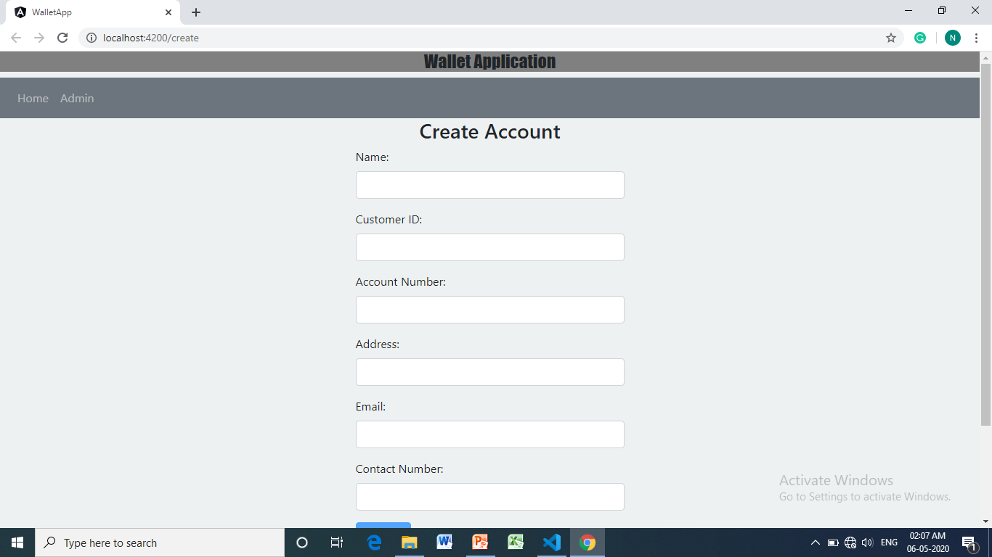
Screenshots of the Application

Slide 6
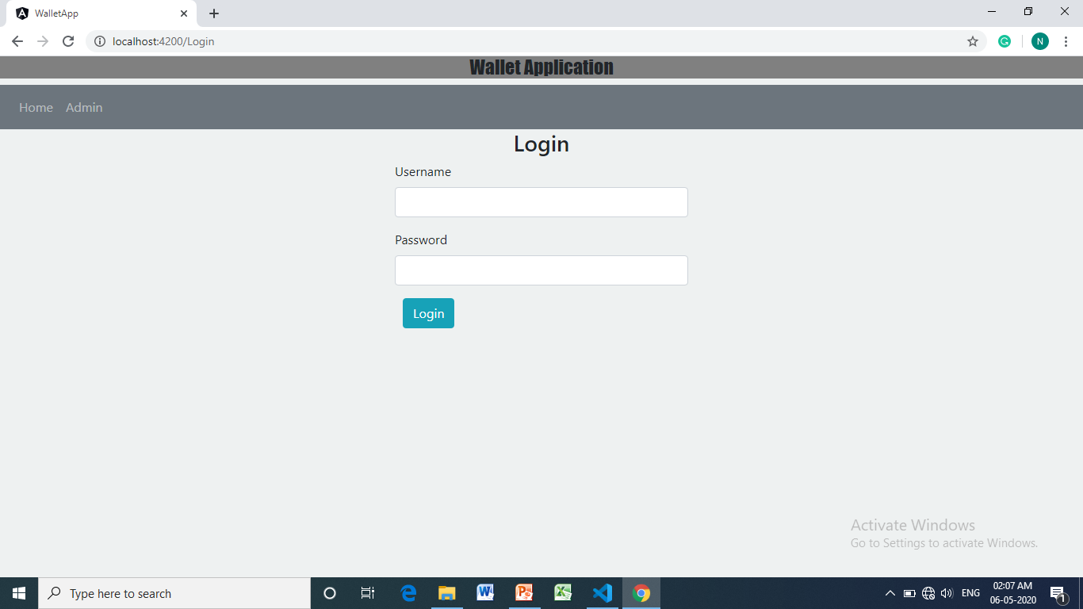
Login

Slide 7
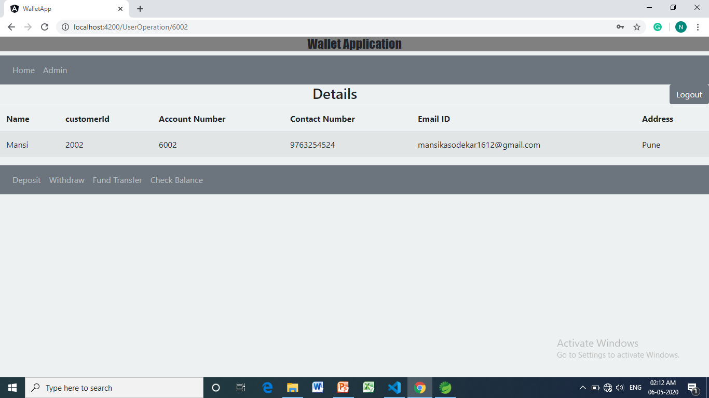
Customer View After Login

Slide 8
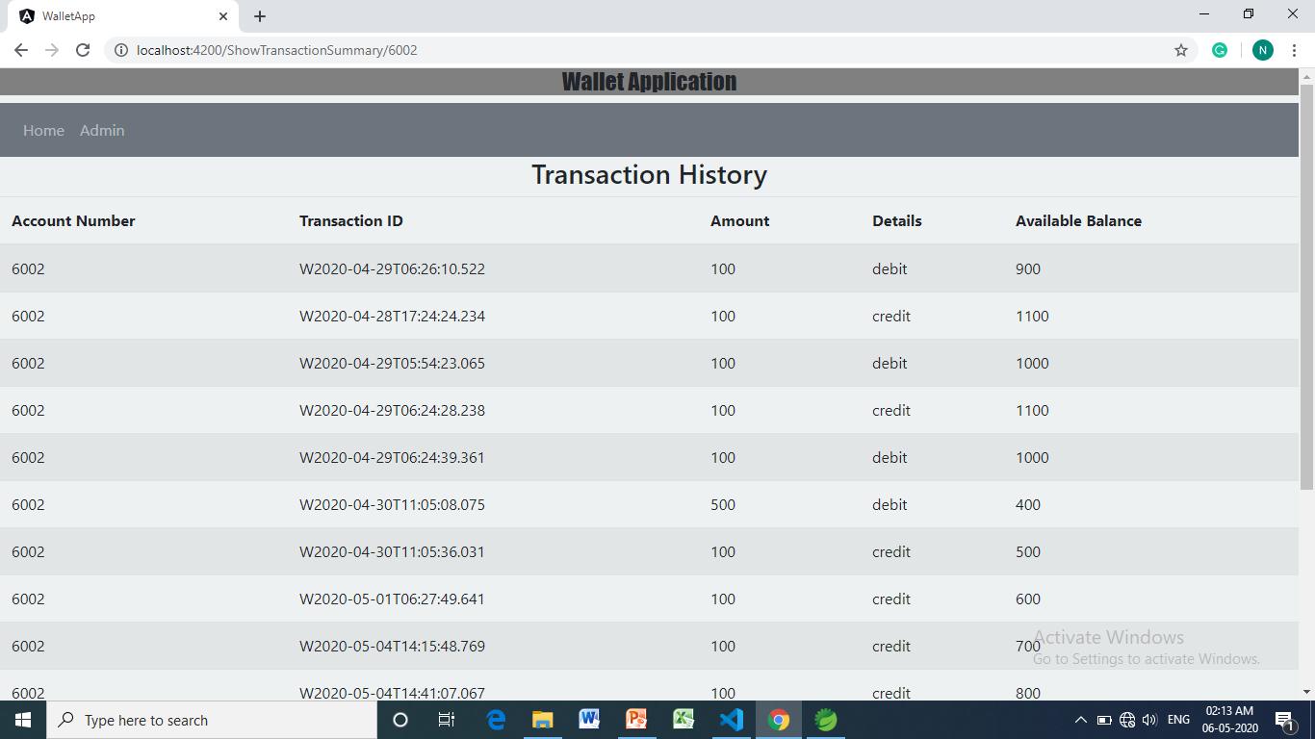
Transaction History after Doing some transaction

Slide 9
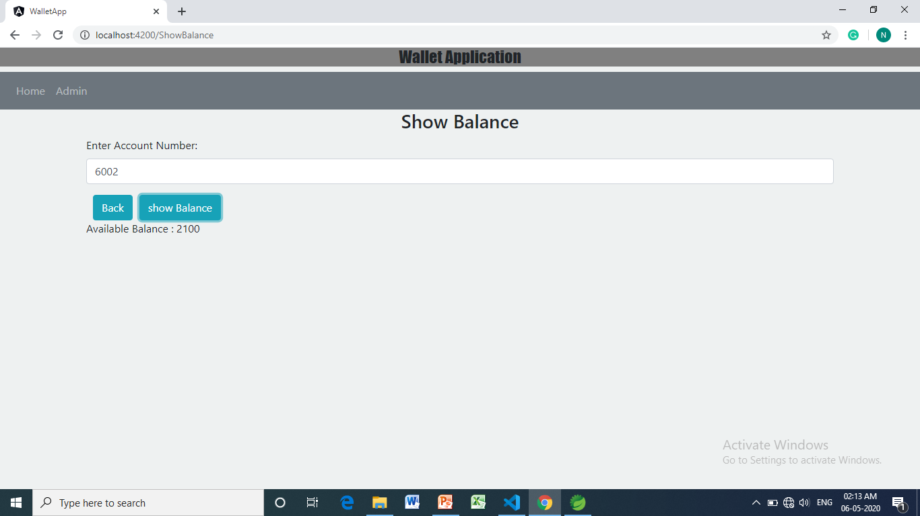
Check Balance

Slide 10
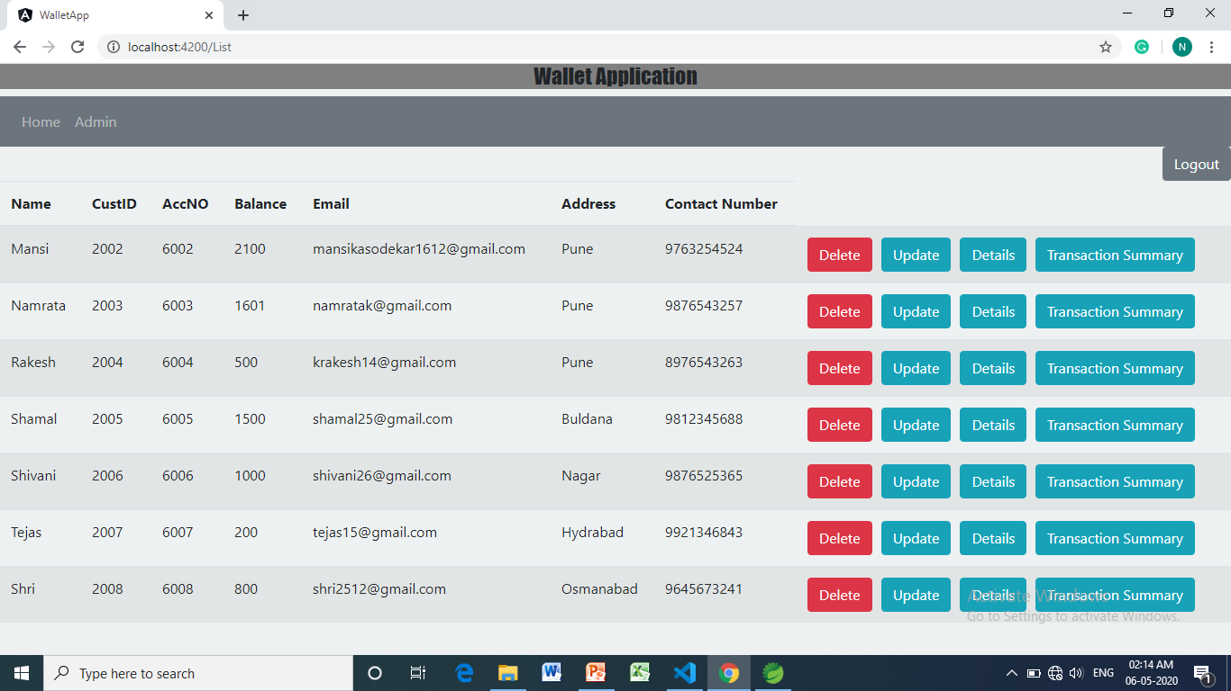
Admin View after Login

Slide 11
Thank You

